Slide 1
Upgrad-Capstone Project 2
By Akash Gaikwad

Slide 2
Project Requirements
Problem Statement:
Kingston Inc, a prominent technology company, faces a crucial challenge in efficiently
configuring, provisioning, and monitoring its Node.js applications. As Kingston Inc continues to
expand its portfolio of Node.js applications, ensuring their smooth deployment, scalability, and
observability has become a top priority. To address this challenge, Kingston Inc aims to
undertake a project focused on configuring, provisioning, and monitoring Node.js applications
effectively. This project aims to ensure the seamless deployment of Node.js applications,
leveraging modern technologies and best practices while embracing the growing demand for
reliable web services.
Objectives:
The primary objective of this project is to efficiently configure, provision, and monitor Node.js
applications, ensuring their smooth deployment, scalability, and observability, while adhering to
modern best practices and technologies.

Slide 3
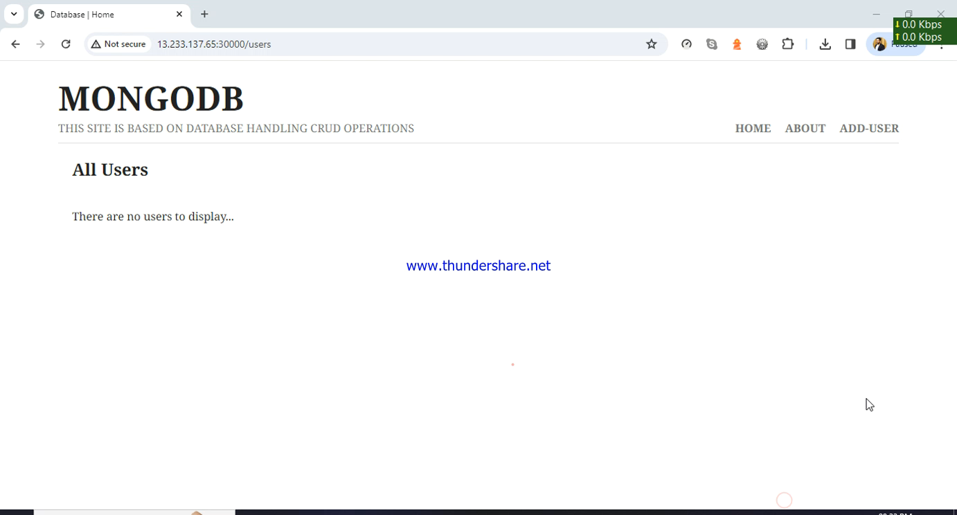
Application Details
This is node based application where, I have used below technologies in development
Node Express.
Web API.
HTML/CSS.
Mongo Db database.
This video shows end to end demo of application.

Slide 4
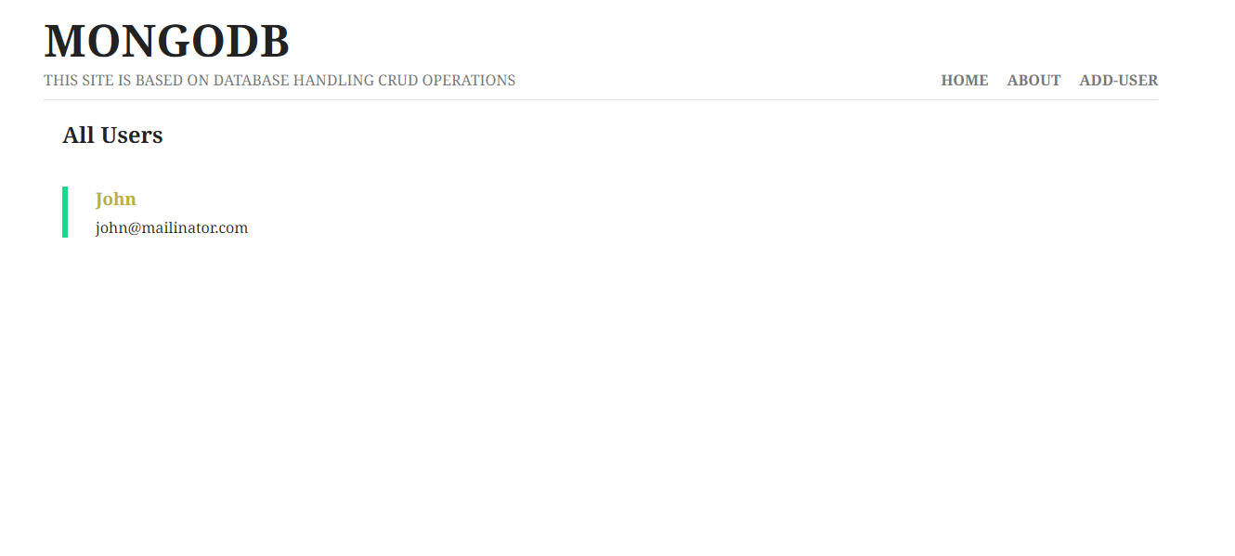
Application Screen-1 List Users
This first screen shows list of users.
Here I have created API which connects to mongo-db and fetches list of users from database.

Slide 5
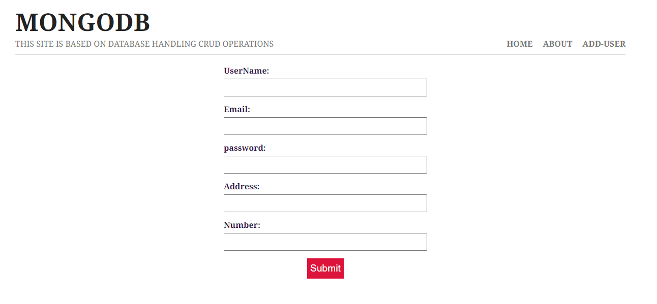
Application Screen-2 Add User
This second screen contains add user functionality.
Added data is saved in mongo dB.

Slide 6
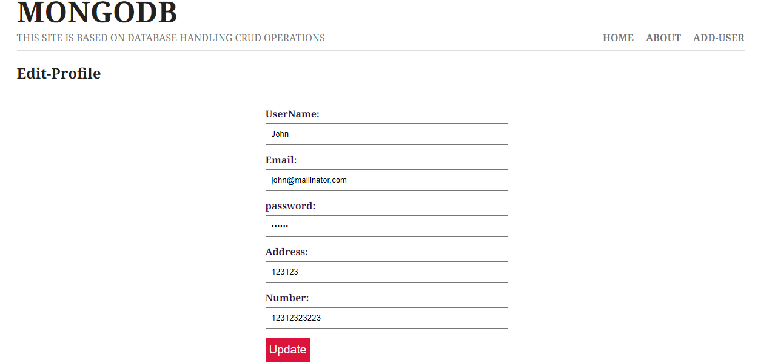
Application Screen-3 Update User
This screen contains update user functionality.
Updated data is saved in mongo dB.

Slide 7
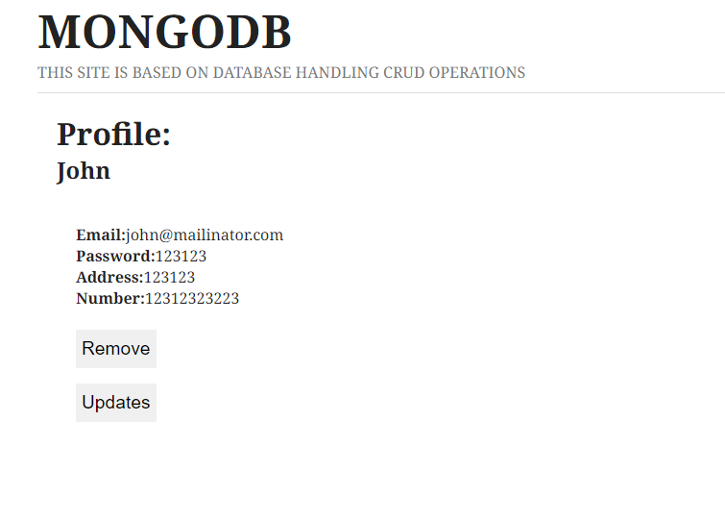
Application Screen-4 Remove User
This screen contains remove user functionality.
Removed data is gets deleted from mongo dB.

Slide 8
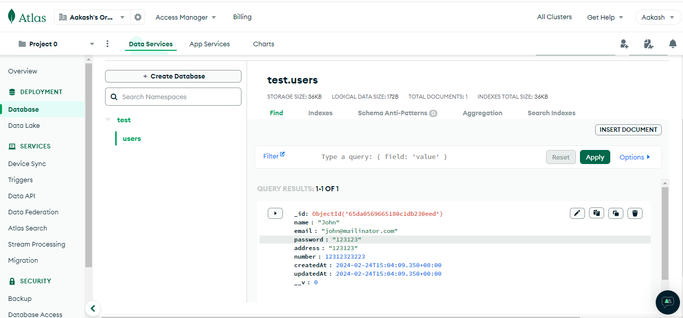
Database screenshot
Below is the database screen shot for the record.

Slide 9
Running & deploying Application
To run application run below command locally
Node app.js
To test application run below command
npm run test
To deploy application please refer readme.md file.
https://github.com/aakashgaikwad/capston_project_node/blob/main/README.md
GIT Repo Link :: https://github.com/aakashgaikwad/capston_project_node.git

